Slide 1
Applications to Download

Slide 2
Google Drive
Get access to files anywhere through secure cloud storage and file backup for photos, videos, and files.
Auto-saves.
Also a website to access
Linked to your school email.

Slide 3
Khan Academy
Videos and lectures to help teach you ANYTHING or help you review!

Slide 4
https://www.khanacademy.org/science/biology/properties-of-carbon/carbon/v/carbon-as-a-building-block-of-life

Slide 5
myHomework
Add classes
Add homework every day
Reminders for turning in assignments and studying for tests

Slide 6
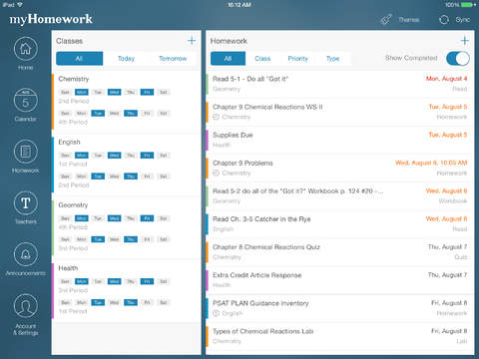
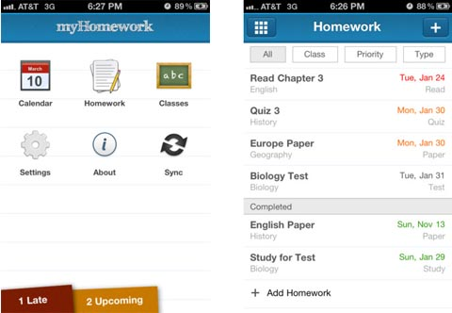

Slide 7
30/30
Set up a list of tasks and a length of time for each one.
Scheduled breaks will occur every hour.

Slide 8
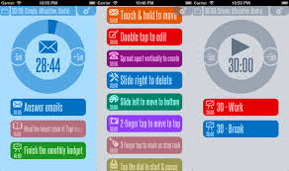
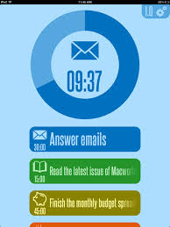

Slide 9
Skyward
Check your grades with the Skyward app – helps so you don’t need to log in every time

Slide 10
Study Blue
Make your own note cards to help you study
Pay for the premium version to gain access to pre-made notecards.

Slide 11
Y Homework solver
Helps you complete algebra problems and shows the work.

Slide 13
Easy Bib
Find the title of your book or scan barcode to create MLA bibliography information

Slide 15
Other fun apps
Canva
Tellagami
Font Candy
Mematic

